Slide 1
Unit IV
IP Security

Slide 2
Outline
Internetworking and Internet Protocols (Appendix 6A)
IP Security Overview
IP Security Architecture
Authentication Header
Encapsulating Security Payload
Combinations of Security Associations
Key Management

Slide 3
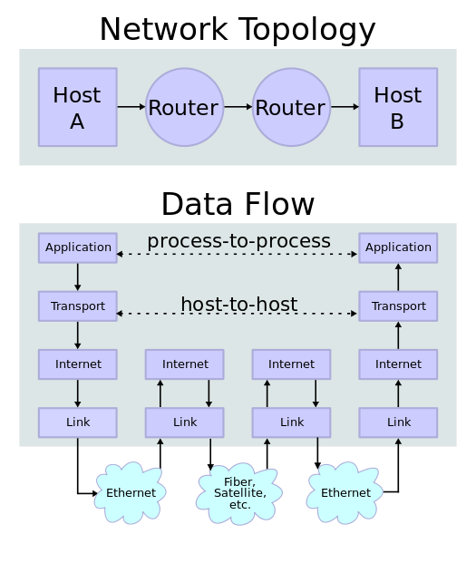
TCP/IP: Network Topology and Data Flow
Application Specific Security Mechanisms:
(PGP, S/MIME)- Email,
Kerberos-Cleint-Server,
Secure Socket Layer (SSL) - Web Access.
IPSec Mechanism; Implements security at the IP level.
This ensures secure networking not only for appliaction with secure mechanisms but also for many security-ignorant applications.

Slide 4
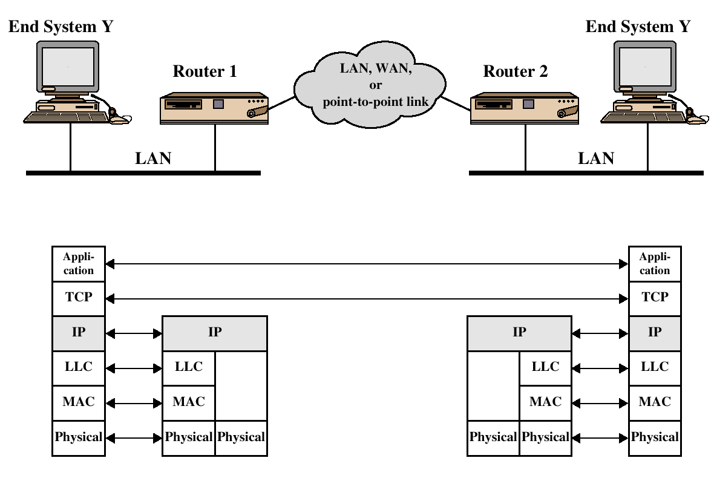
TCP/IP Example
Role of Internet Protocol (IP)
IP provides end-to-end connectivity between systems specifying how data should be packetized, addressed, transmitted, routed and received at the destination.

Slide 5
IP and Router
For interconnecting, IP is implemented in each end system and routers (router: device to provide connection between networks).
Router must be able to cope with variety of differences:
  Addressing schemes
  Maximum Packet Size
  Interfaces
  Reliability

Slide 6
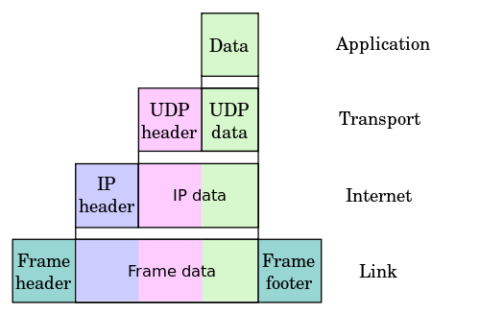
Encapsulation of application data descending through the layers
GlobalInternetAddress(Y)
  Network Id
  EndSystemId
Addressing Information
MAC Header
MAC Layer
Address of Router 1

Slide 7
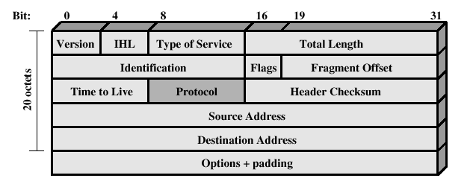
IPv4 Header
160 bits: 5 x 32-bit words

Slide 8
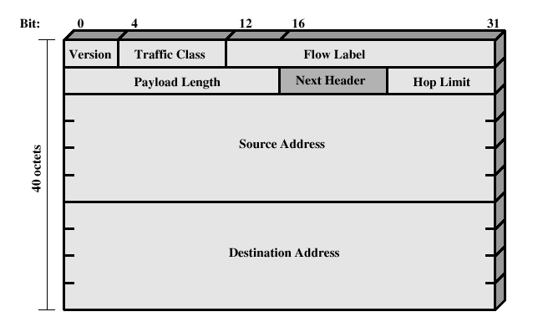
IPv6 Header
Total: 320 bits: 10 x 32-bit words.
2 32-bit words for version, payload details.
8 32-bit words=128-bit addresses for source and destination each.

Slide 9
Ipv6 : Extension Headers (EH)
Extension headers are an intrinsic part of the IPv6 protocol
  they support some basic functions and certain services.
The following is a list of EHs are commonly used:
Hop-by-Hop EH Defines special options that require hop-by-hop processing.
Routing EH provides extended routing, similar to IPv4 source routing
Fragmentation EH contains fragmentation and reassembly information
Destination Options Header EH Contains optional information to be examined by the destination node.
Authentication EH provides packet integrity and authentication
Encapsulating Security Payload EH provides privacy

Slide 10
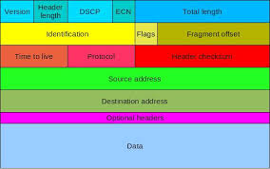
Order of the IPv6 headers
1. IPv6 main header
2. Hop-by-Hop Options header (if present, it MUST be the first one following the main/regular header)
3. Destination Options header
4. Routing header
5. Fragment header
6. Authentication header
7. Encapsulating Security Payload header
8. Destination Options header

Slide 11
Significance of IPSec
IPSec Mechanism; Implements security at the IP level.
This ensures secure networking not only for application with secure mechanisms but also for many security-ignorant applications.
IPSec is a capability that can be added to either current version of the Internet Protocol (IPv4 or IPv6), by means of additional headers.
It encompasses 3 functional areas: Authentication, Confidentiality and Key Management.

Slide 12
IP Security Overview
IPSec is not a single protocol. Instead, IPSec provides
a set of security algorithms
general framework that allows a pair of communicating entities to use whichever algorithms provide security appropriate for the communication.

Slide 13

IP Security Overview
Applications of IPSec
  Secure branch office connectivity over the Internet
  Secure remote access over the Internet
  Establishing extranet and intranet connectivity with partners
  Enhancing electronic commerce security

Slide 14
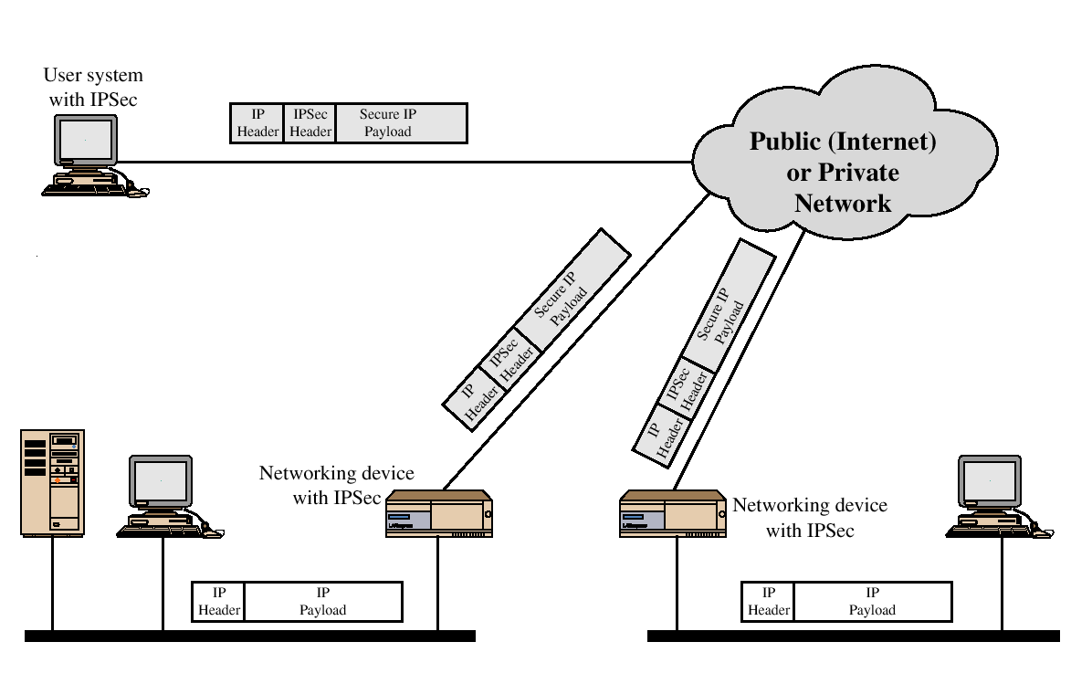
IP Security Scenario

Slide 15
IP Security Overview
Benefits of IPSec
  Transparent to applications (IPSec lies below transport layer (TCP, UDP))
  Provide security for individual users
IPSec can assure that:
  A router or neighbor advertisement comes from an authorized router
  A redirect message comes from the router to which the initial packet was sent
  A routing update is not forged

Slide 16
IP Security Architecture
IPSec documents:
  RFC 2401: An overview of security architecture
  RFC 2402: Description of a packet authentication extension to IPv4 and IPv6
  RFC 2406: Description of a packet encryption extension to IPv4 and IPv6
  RFC 2408: Specification of key managament capabilities

Slide 17
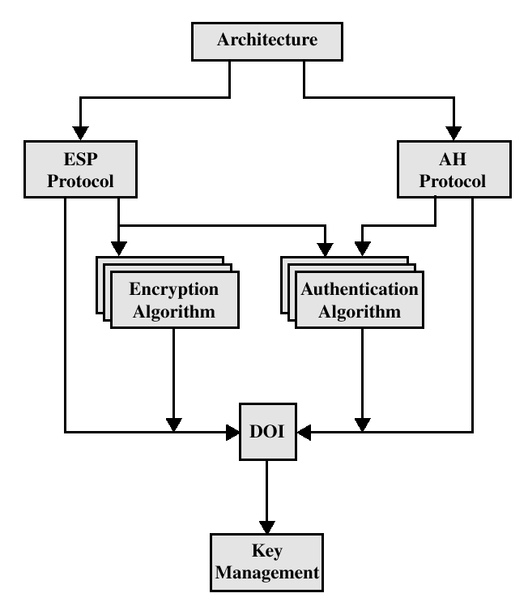
IPSec Document Overview

Slide 18
IPSec Services
IPSec provides security services at the IP layer by enabling a system to
  Select required security protocols
  Determine algorithms to use for services
  Establish the keys required for services.
Services
Access Control
Connectionless integrity
Data origin authentication
Rejection of replayed packets
Confidentiality (encryption)
Limited traffic flow confidentiallity

Slide 19
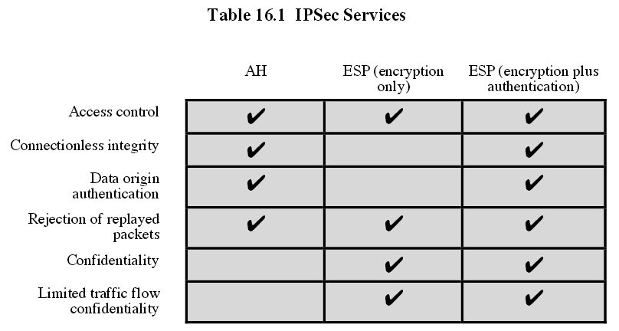
Services provided by the AH and ESP protocols

Slide 20
Security associations (SA)
A one-way relationship between a sender and a receiver system
Used either for AH or for ESP but never for both
an SA is uniquely identified by three parameters
  Security Parameters Index (SPI)
    a bit string assigned to the SA
    carried in AH and ESP headers to allow the receiving party to select the SA which must be used to process the packet
  IP destination address
    address of an end-system or a network element (e.g., router)
  security protocol identifier
    indicates whether the SA is an AH or an ESP SA

Slide 21
SA parameters
sequence number counter
  counts the packets sent using this SA
sequence counter overflow flag
  indicates whether overflow of the sequence number counter should prevent further transmission using this SA
anti-replay window
  used to determine whether an inbound AH or ESP packet is a replay
AH / ESP information
  algorithm, key, and related parameters
lifetime
  a time interval or byte count after which this SA must be terminated
protocol mode
  tunnel or transport mode
path MTU
  any observed maximum transmission unit

Slide 22
SA selectors
Security Policy Database (SPD)
  each entry defines a subset of IP traffic and points to the SAs to be applied to that traffic
  subset of IP traffic is defined in terms of selectors
    destination IP address (single, enumerated list, range, or mask)
    source IP address (single, enumerated list, range, or mask)
    transport layer protocol (single, enumerated list, or range)
    Source & destination port (single, enumerated list, range, or wildcard)
outbound processing
  compare the selector fields of the packet to the values in the SPD
  determine which SAs should be used for the packet and their SPIs
  do the requiered IPSec processing

Slide 23
Security Policy Database (SPD) and Security Association Database (SAD)
SPD specifies the policies that determine the disposition of all IP traffic inbound or outbound from a host or a security gateway.
SAD is a security association table, containing parameters that are associated with each security association.

Slide 24
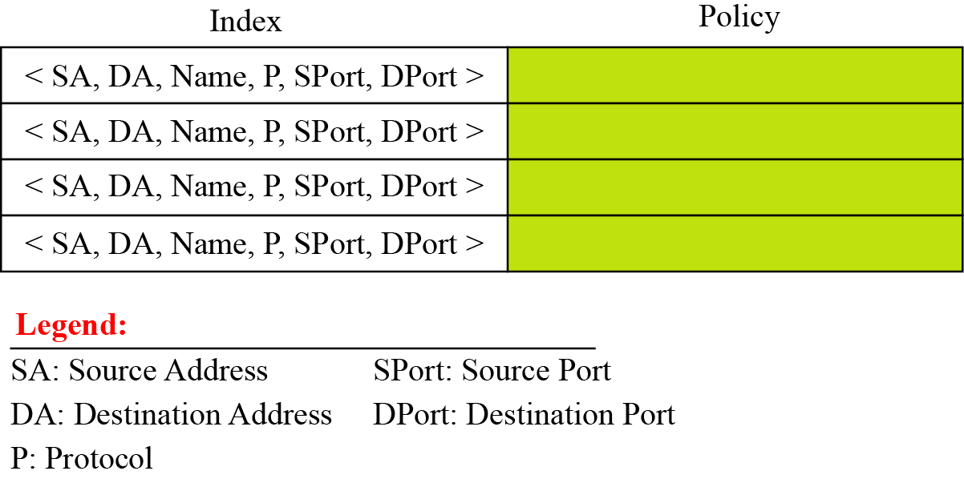
Figure Connection identifiers
Selectors to determine an SPD

Slide 25
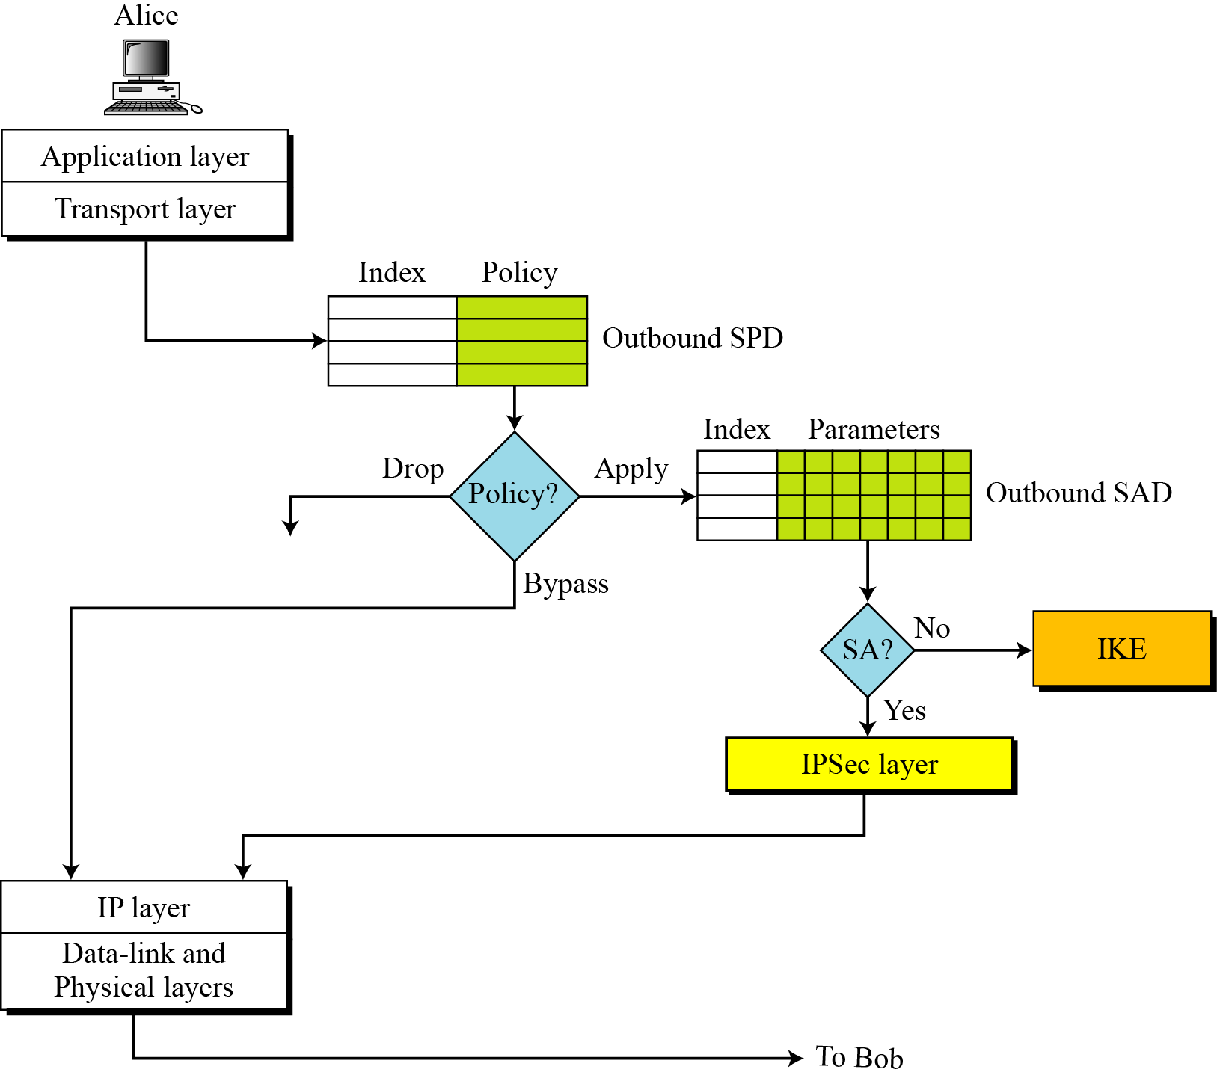
Figure Outbound processing

Slide 26
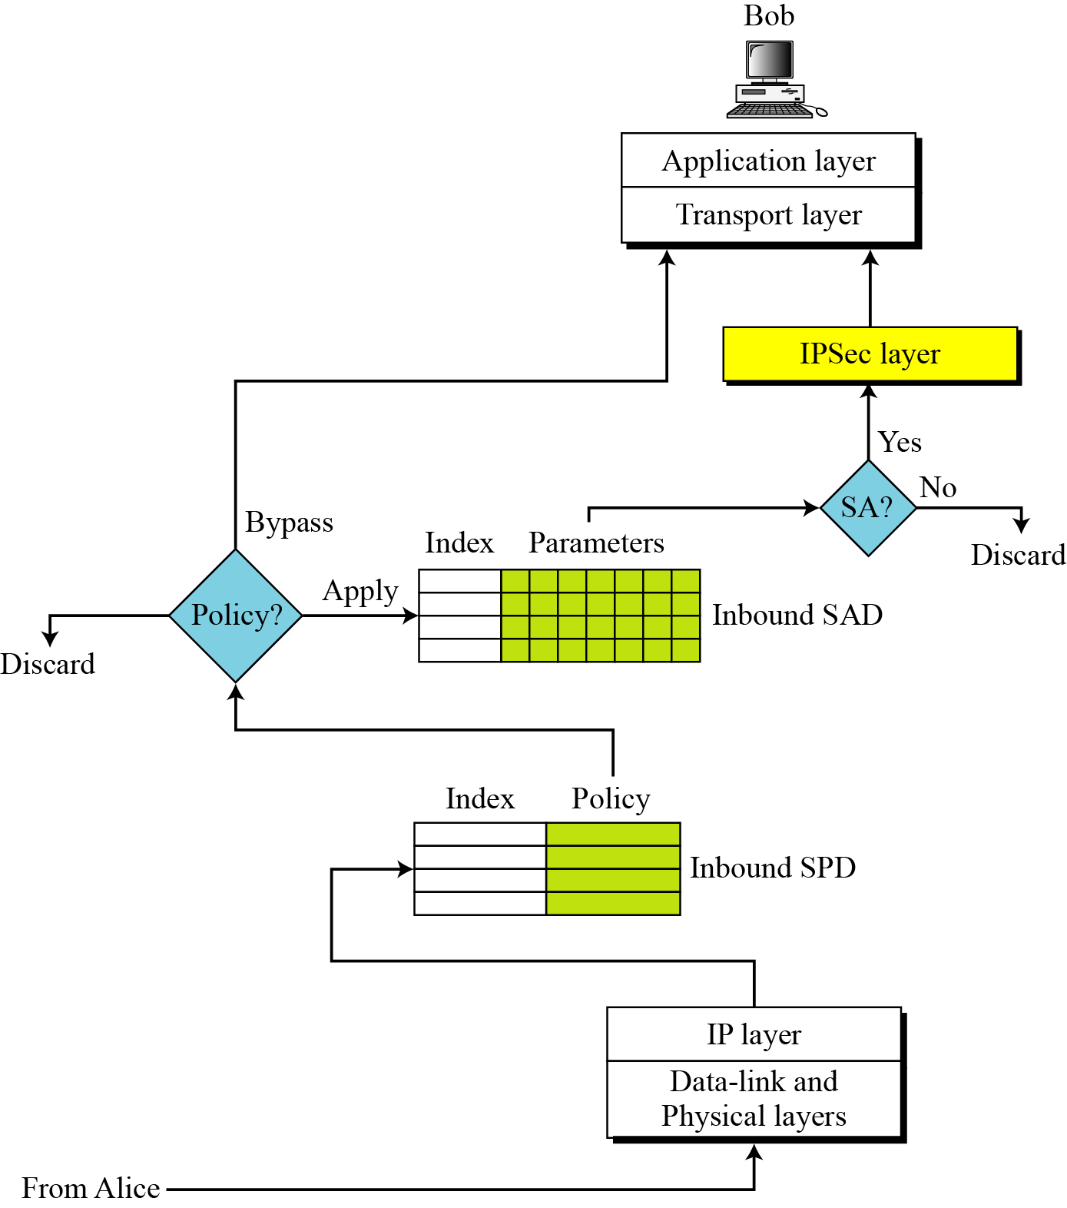
Figure Inbound processing

Slide 27
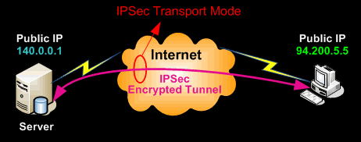
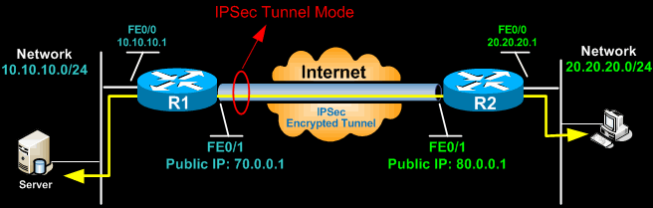
Modes of operation – transport and tunnel mode

Slide 28



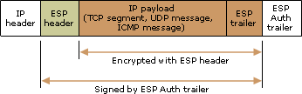
Modes of operation – transport and tunnel mode
Purpose of Modes of Operation: Interoperability
1. transport mode
  default mode
  provides protection primarily for upper layer protocols
  usually used between end-systems
  protection is applied to the payload of the IP packet
    AH in transport mode authenticates the IP payload and selected fields of the IP header
    ESP in transport mode encrypts and optionally authenticates the IP payload but not the IP header

Slide 29
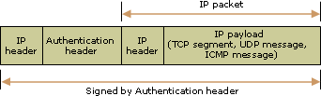
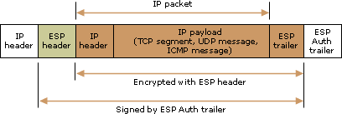
tunnel mode
  usually used between security gateways (routers, firewalls) for interoperability like Gateway-to-gateway, Server-to-gateway, Server-to-server
  useful for protecting traffic between different and untrusted networks
  provides protection to the entire IP packet
  the entire IP packet is considered as payload and encapsulated in another IP packet (with potentially different source and destination addresses)
    AH in transport mode authenticates the entire inner IP packet and selected fields of the outer IP header
    ESP in tunnel mode encrypts and optionally authenticates the entire inner IP packet

Slide 30
 | Transport Mode SA | Tunnel Mode SA
AH | Authenticates IP payload and selected portions of IP header and IPv6 extension headers | Authenticates entire inner IP packet plus selected portions of outer IP header
ESP | Encrypts IP payload and any IPv6 extesion header | Encrypts inner IP packet
ESP with authentication | Encrypts IP payload and any IPv6 extesion header. Authenticates IP payload but no IP header | Encrypts inner IP packet. Authenticates inner IP packet.

Slide 31
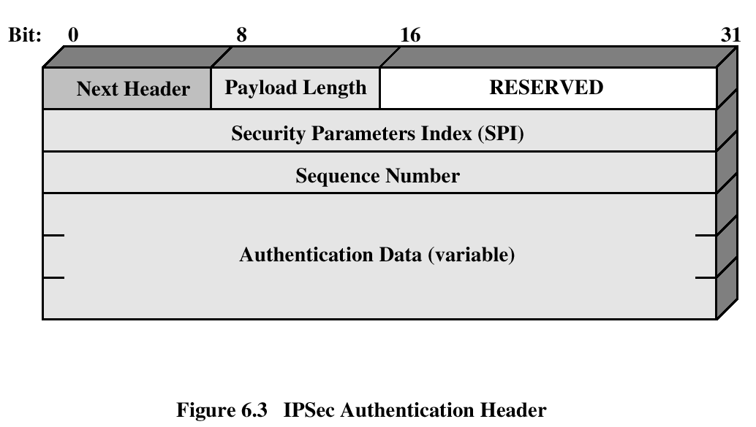
Authentication Header
Provides support for data integrity and authentication (MAC code) of IP packets.
Guards against replay attacks-provides antiRplay Service.
Integrity Check Value

Slide 32
Authentication Header – AH
0
8
16
31
Next header
  type of header immediately following this header (e.g., TCP, IP, etc.)
Payload length
  length of AH (in 32 bit words) minus 2
Security Parameters Index
  identifies the SA used to generate this header
Sequence number
  sequence number of the packet
Authentication data
  a (truncated) MAC or ICV(default length is 3x32 bits)
Next
header
Payload
length
Reserved
Security Parameters Index (SPI)
Sequence number
Authentication data
(variable length)

Slide 33
Replay detection
replay: the attacker obtains an authenticated packet and later transmits (replays) it to the intended destination
anti-replay mechanism works by keeping track of the sequence numbers in packets as they arrive.
receiver has an anti-replay window of default size W = 64
N last received packet
packets received
Window W (of size 64)
...
…
...
…
N
dropped
dropped
if MAC is
correct then
mark
otherwise
drop
advance
window

Slide 34
Integrity Check Value - ICV
Keyed Message authentication code (MAC)
Standards used are
  HMAC-SHA-1-96
  HMAC-MD5-96
calculated over
  IP header field that do not change in transit(immutable) or that are predictable upon arrival.
    Source IP address, destination IP, header length, etc.
    Prevent spoofing(because both source and destination address fields are protected)
    Mutable fields that are zeroed prior to ICV calculation are : time-to-live (TTL), IP header checksum, etc.
  The AH header other than Authentication Data field.
  Upper-level data

Slide 35
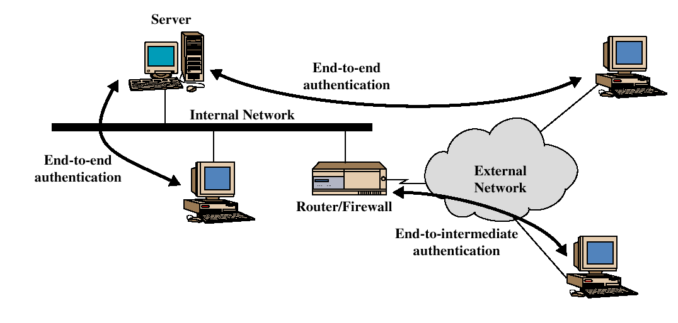
End-to-end versus End-to-Intermediate Authentication

Slide 36
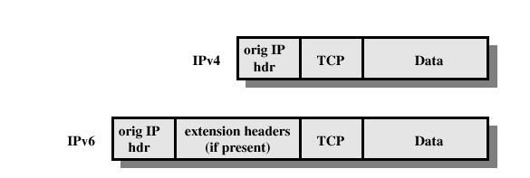
Before applying AH

Slide 37
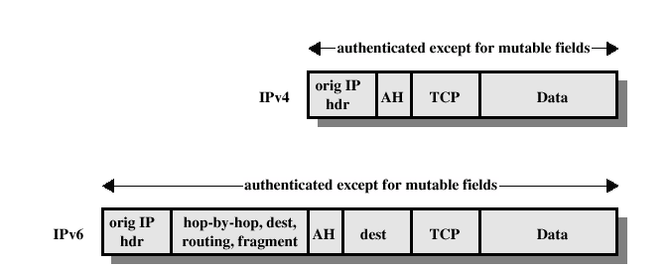
Transport Mode (AH Authentication)

Slide 38
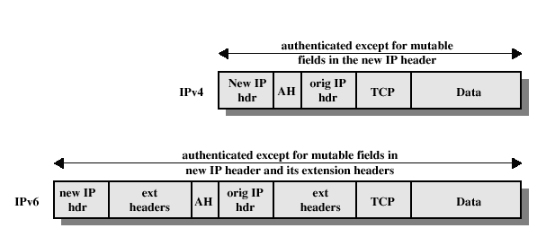
Tunnel Mode (AH Authentication)

Slide 39
Encapsulating Security Payload (ESP)
Provides all that AH offers, and
in addition provides data confidentiality
  Uses symmetric key encryption

Slide 40
ESP Details
Same as AH:
  Use 32-bit sequence number to counter replaying attacks
  Use integrity check algorithms
Only in ESP:
  Data confidentiality:
    Uses symmetric key encryption algorithms to encrypt packets

Slide 41
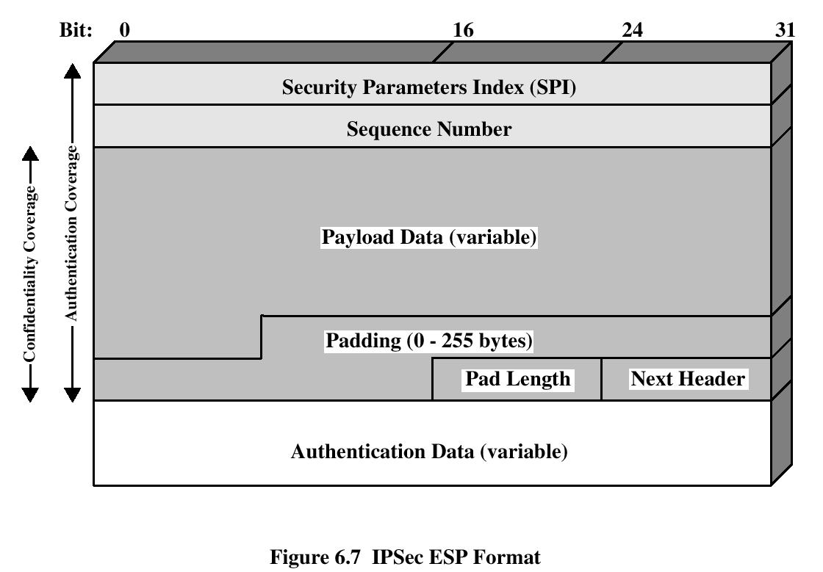
Encapsulating Security Payload
ESP provides confidentiality services

Slide 42
Encapsulating Security Payload – ESP
0
16
24
31
Security Parameters Index
  identifies the SA used to generate this encrypted packet
Sequence number
payload
  transport level segment (transfer mode) or encapsulated IP packet (tunnel mode)
Padding(0-255 bytes)
  variable length padding
Pad length (8 bits):
Next header
  identifies the type of data contained in the payload
Authentication data
  a (truncated) MAC computed over the ESP packet (SPI ... Next Header)
Security Parameters Index (SPI)
Sequence number
payload
(variable length)
padding (0-255 bytes)
Pad
length
Next
header
Authentication data
(variable length)

Slide 43
Encryption and MAC algorithms
encryption
  applied to the payload, padding, pad length, and next header fields
  implementations must support DES-CBC
  other suggested algorithms: 3DES, RC5, IDEA, 3IDEA, CAST, Blowfish
MAC
  default length is 3x32 bits
  implementations must support HMAC-MD5-96 and HMAC-SHA1-96
  MAC is computed over the SPI, sequence number, and encrypted payload, padding, pad length, and next header fields

Slide 44
Padding:
If an encryption algorithm requires the plaintext to be a multiple of some number of bytes, this field is used to expand the plaintext to required length.
The ESP format requires that the Pad Length and Next Header fields be right aligned within a 32-bit word. Equivalently, the cipher text must be an integer multiple of 32 bits. The Padding field is used to assure this alignment.
Additional Padding may be added to provide partial traffic flow confidentiality by concealing the actual length of the payload.

Slide 45
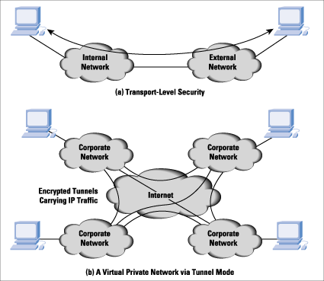
Transport vs. Tunnel mode

Slide 46
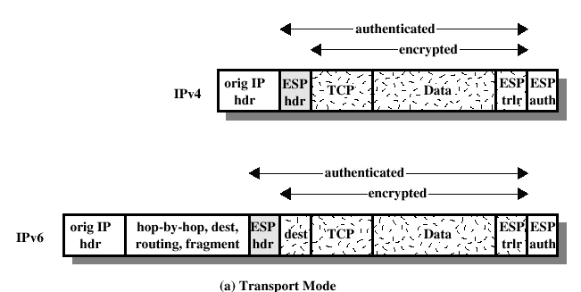
ESP Encryption and Authentication

Slide 47
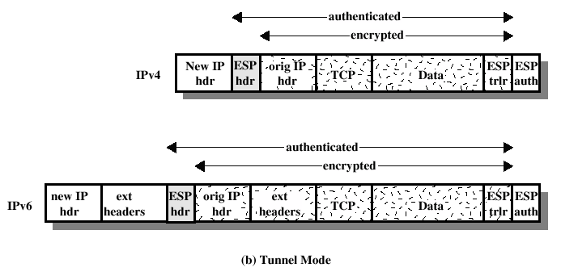
ESP Encryption and Authentication

Slide 48
Combining security associations
Security Associations can be combined into bundles in two ways:
Transport Adjacency: Refers to applying more than one security protocol to the same IP packet, without invoking tunneling.
Iterated Tunneling: Refers to application of multiple layers of security protocols effected through Tunneling.
Authentication Plus Confidentiality:
Encryption and Authentication can be combined in order to transmit an IP packet that has both .
Transport mode ESP
Tunnel mode ESP.

Slide 49
Combining security associations
basic ESP-AH combination(Transport Adjacency)
  apply ESP in transport mode without authentication
  apply AH in transport mode
basic AH-ESP combination(Transport-Tunnel Bundle)
  apply AH in transport mode
  apply ESP in tunnel mode without authentication
original
IP header
AH
ESP
header
TCP/UDP
header
data
ESP
trailer
authenticated except for mutable fields in the IP header
new
IP header
ESP
header
original
IP header
AH
TCP/UDP
header
data
ESP
trailer
authenticated except for mutable fields in the inner IP header

Slide 50
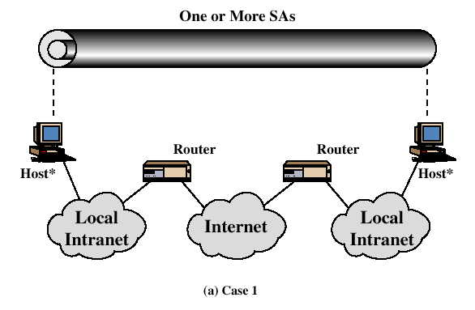
Combinations of Security Associations
case 1: host-to-host security

Slide 51
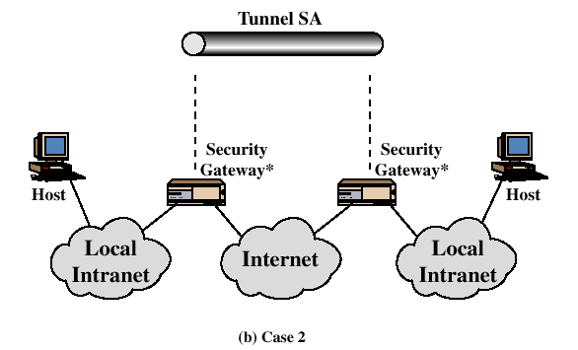
Combinations of Security Associations
case 2: gateway-to-gateway security

Slide 52
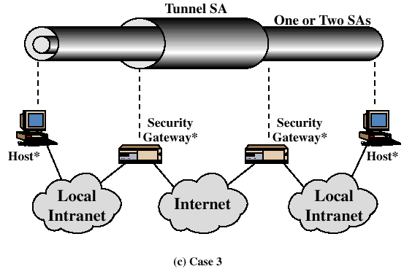
Combinations of Security Associations
case 3: host-to-gateway security

Slide 53
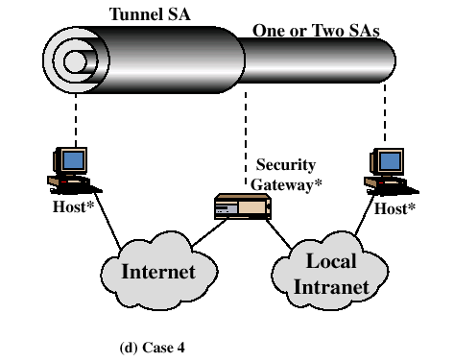
Combinations of Security Associations
combinations of the 3 cases

Slide 54
Key management
two types must be supported by implementations
  manual
    system administrator configures each system with the necessary keys
  automated
    on-demand creation of keys for SAs
default automated method is ISAKMP/Oakley
  Oakley key determination protocol
    a key exchange protocol based on Diffie-Hellman
    provides added security (e.g., authentication)
  ISAKMP – Internet Security Association and Key Management Protocol
    provides a framework for key exchange
    defines message formats that can carry the messages of various key exchange protocols

Slide 55
Oakley key determination protocol
Problems with basic DH:
  it is subject to a man-in-the-middle type attack
  it is vulnerable to a clogging attack
    attacker sends fake DH messages to a victim from a forged IP address
    victim starts performing modular exponentiations to compute a secret key
    victim can be blocked with useless work

Slide 56
Added security features of Oakley
  cookie exchange to thwart clogging attacks
    hash(src IP addr, dst IP addr, src UDP port, dst UDP port, local secret)
    local secret is periodically changed
  uses nonces to detect replay attacks
  authenticates the DH exchange to thwart man-in-the-middle attacks
    based on digital signatures, public key encryption, or symmetric key encryption
  enables the parties to negotiate the global parameters of the DH exchange (e.g., the prime p that defines the group and the generator g of the group)
    few predefined groups
  It enables exchange of Diffie-Hellman Public key values.

Slide 57
Cookie generation
The cookie must satisfy 3 basic requirements:
A cookie must depend on specific parties, the UDP source and destination ports, and
a locally generated secret value.
a fast hash (e.g. MD5) over the IP source and destination addresses

Slide 58
OAKLEY supports different groups for the Diffie-Hellman key exchange
DH Group 1: 768-bit group
DH Group 2: 1024-bit group
DH Group 5: 1536-bit group
DH Group 14: 2048-bit group
DH Group 15: 3072-bit group
DH Group 19: 256-bit elliptic curve group
DH Group 20: 384-bit elliptic curve group

Slide 59
Oakley
Three authentication methods:
  Digital signatures
  Public-key encryption
  Symmetric-key encryption

Slide 60
Oakley example – aggressive
I → R: CKY_{i} | OK_KEYX | GRP | g^{x} | EHAO | NIDP | ID_{i} | ID_{r} | N_{i} |
S_{Ki}(ID_{i} | ID_{r} | N_{i} | GRP | g^{x} | EHAO )
R → I: CKY_{r} | CKY_{i} | OK_KEYX | GRP | g^{y} | EHAS | NIDP | ID_{r} | ID_{i} | N_{r} | N_{i} |
S_{Kr} (ID_{r} | ID_{i} | N_{r} | N_{i} | GRP | g^{y} | g^{x} | EHAS )
I → R: CKY_{i} | CKY_{r} | OK_KEYX | GRP | g^{x} | NIDP | ID_{i} | ID_{r} | N_{i} | N_{r} |
Sig( K_{i}⁻¹, ID_{i} | ID_{r} | N_{i} | N_{r} | GRP | g^{x} | g^{y} | EHAS )
where
  I,R: Initiator, Responder
  CKY: cookie
  OK_KEYX: message type is Oakley key exchange
  GRP: group
  g^{x} g^{y}: public key of I and R
  EHAO/EHAS: encryption, hash, authentication alg. offered/selected
  NIDP: no ID protection
  N: nonce
  S_{Ki}[X], S_{Kr}[X]= Signature over X using private key (signing key)of initiator, responder

Slide 61
ISAKMP
Defines procedures and packet formats to establish, negotiate, modify and delete SAs.
ISAKMP only provides a framework for exchanging key generation and authentication data.
ISAKMP is distinct from key exchange protocols.
There may be many different key exchange protocols, each with different security properties.
However, a common framework (: ISAKMP) is required for agreeing to the format of SA attributes, and for negotiating, modifying, and deleting SAs

Slide 62
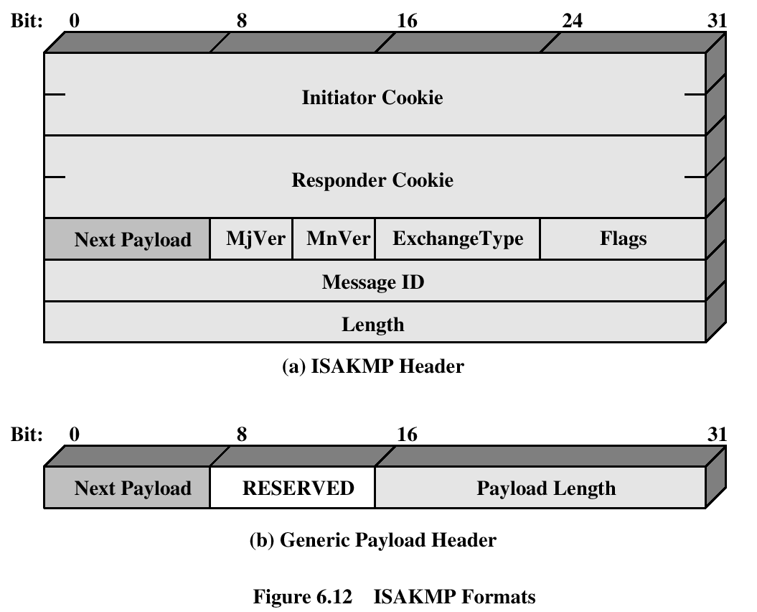
ISAKMP

Slide 63
ISAKMP generic message format
Initiator cookie
Next payload
  type of next payload (e.g., transform, key exchange, certificate, …)
  0 if this is the last payload
Exchange type
  5 default exchange types (base, ID protection, auth only, aggressive, informational)
Message ID
  unique ID of this message
Length
  length of header + all payloads
Responder cookie
Next
payload
Mj
ver
Mn
Ver
Exchange
type
Flags
Message ID
Length
Next
payload
Reserved
Payload length
payload

Slide 64
ISAKMP payload types
Security Association (SA)- used to begin the setup of a new SA; carries various attributes
Proposal (P)- used during SA setup; indicates protocol to be used (AH or ESP) and number of transforms
Transform (T)- used during SA setup; indicates transform (e.g., DES, 3DES) and its attributes
Key exchange (KE)- used to carry key exchange data (e.g., Oakley)
Identification (ID)- used to exchange identification information (e.g., IP address)
Certificate (CR)- carries a public key certificate (PGP, X.509, Kerberos tokens, …)
Hash (HASH)
Signature (SIG)
Nonce (NONCE)
Notification (N)- contains error or status information
Delete (D)- indicates one or more SAs that the sender has deleted from its database (no longer valid)

Slide 65
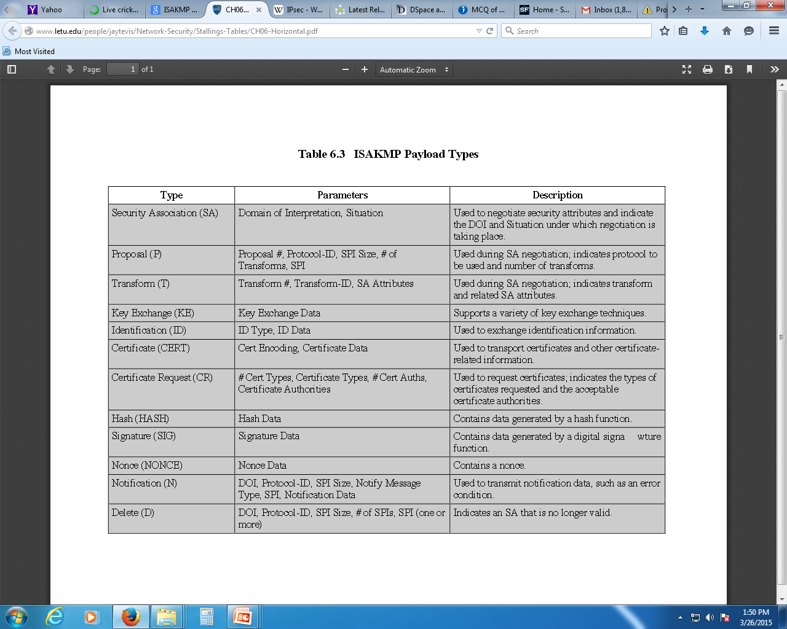

Slide 66
ISAKMP exchange types
base exchange
identity protection exchange
authentication only exchange
aggressive exchange
informational exchange

Slide 67
ISAKMP exchange types contd.
base exchange
    I → R : SA; NONCE
    R → I : SA; NONCE
    I → R : KE; ID_{i}; AUTH
    R → I : KE; ID_{r}; AUTH
identity protection exchange
    I → R : SA
    R → I : SA
    I → R : KE; NONCE
    R → I : KE; NONCE
    I → R : ID_{i}; AUTH
    R → I : ID_{r}; AUTH

Slide 68
ISAKMP exchange types contd.
authentication only exchange
    I → R : SA; NONCE
    R → I : SA; NONCE; ID_{r}; AUTH
    I → R : ID_{i}; AUTH
aggressive exchange
    I → R : SA; KE; NONCE; ID_{i}
    R → I : SA; KE; NONCE; ID_{r}; AUTH
    I → R : AUTH
informational exchange
    I → R : N/D

